Slide 1
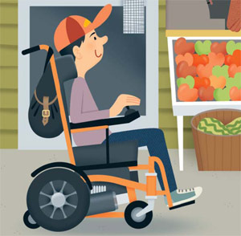
Early intervention, Transition and School Integration of Children with Cerebral Palsy
Dr. Ioulia Nisiotou
Special Education Department
University of Thessaly, Volos, Greece
email: nisiotou@uth.gr
Notes:
Cerebral Palsy affects the global development and quality of life, since movement and posture disorders are often accompanied by other disabilities, due to cerebral lesions modifying structure, function and connectivity of several parts of the developing brain, in addition to the motor cortex lesion. Movement and posture disorders are essential in diagnosing CP, but their assessment is just one of the parameters of clinical evaluation, as the comorbid impairments of communication and behavior, cognitive deficits, epilepsy, allow us to consider CP as a global developmental disorder and not just a mobility disorder.

Slide 2
Co-occurring impairments and functional limitations
“Among children with cerebral palsy,
3 in 4 are in pain; 1 in 2 has an intellectual disability; 1 in 3 cannot walk; 1 in 3 has a hip displacement; 1 in 4 cannot talk; 1 in 4 has epilepsy; 1 in 4 has a behavior disorder; 1 in 4 has bladder control problems; 1 in 5 has sleep disorders; 1 in 5 dribbles; 1 in 10 is blind; 1 in 15 is tube-fed; and 1 in 25 is deaf”.
Novac et al.,2012
Notes:
By means of a systematic review of the literature, (over one thousand papers), in order to summarize the rates of co-occurring impairments and functional limitations, Novac and her collaborates, from Australia, concluded that ……

Slide 3
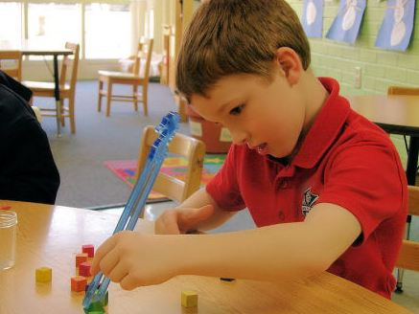
Experience dependent synaptogenesis: memory & learning
Notes:
Experience- dependent synaptogenesis and formation of a huge number of synapses during the first year of life and the pre-school period enhances memory and learning, as well as behavior modification and social adaptation. Early intervention takes advantage of this “opportunity window”:

Slide 4
Early Intervention
“A systematic approach to early intervention is an ideal framework for integrating new knowledge and making use of it in clear and comprehensive programs for children and their families.”
Guralnick, 2017
The understanding of developmental mechanisms in vulnerable children, the accumulated knowledge of growth-enhancing strategies and the great variety of approaches and interventions highlight the complexity of needs, but also the enthusiasm and commitment of the scientists involved in Early Intervention.
Notes:
Experience- dependent synaptogenesis and formation of a huge number of synapses during the first year of life and the pre-school period enhances memory and learning, as well as behavior modification and social adaptation. Early intervention takes advantage of this “opportunity window”: parents, therapists and teachers have to collaborate to minimize the adverse results and offer a better future to children with CP.

Slide 5
Early intervention in C.P.
Early intervention should not be oriented only to gross and fine motor improvement; children suffering from C.P. must be prepared to face the “real world”- school and society -, through educational interventions and family supporting.
Transitions:
From home to kindergarten
From kindergarten to school
Notes:
Nowadays, early, accurate diagnosis of cerebral palsy, within the first year of life, allows specific early intervention to optimize neuroplasticity and function. As they grow up, children with CP will have to make more transitions and to face more challenges : from primary to high school, to university, may be, from the protecting school world to work, but, fro the pediatric point of view, these first adaptations are crucial for the whole life trajectory and worth every effort from those who take care of a child at risk.

Slide 6
Cognitive impairment is the most important barrier to school integration for children with C.P.
Assessment of language comprehension, visual-spatial reasoning, attention, working memory, memory and executive functioning provide useful information about the neuropsychological profile of children with cerebral palsy and their cognitive quotient (CQ).
Perceptual reasoning, verbal comprehension and communication skills may be impaired and have an impact on school integration. Individual assessment will facilitate goal setting and planning of interventions.
Notes:
Most of the children with low CQ have quadriplegic C.P, but children with average CQ may have several impairments I will focus on the most important of them.

Slide 7
Perceptual reasoning
Perceptual reasoning is the ability to use sensory (and especially visual) information to understand and interact with the world. This ability will play a major role in children’s academic success, since perceptual difficulties impact on learning in all areas of development.
Difficulties with interpreting information from the senses; judging the size and shape of objects, moving around obstacles, distinguishing between different sounds and understanding spatial positions.
WISC-IV test

Slide 8
Good practices for parents, special education teachers and occupational therapists: creating a good learning environment
Teach the child spatial vocabulary from an early age: teach words that describe shape, size, texture, and the spatial relationships between objects, such as:
2 and 3-dimensional shape words: triangle, circle, cube, sphere.
Shape descriptors: curved, straight, round.
Texture words: smooth, rough, soft.
Words that describe spatial relationships: under, over, near, left, and right.
Comparative words: bigger, smaller, shorter, longer.
Notes:
If kids have the words to describe an object they are seeing or manipulating, it can help them think about it in more complex ways.

Slide 9
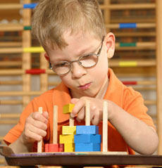
Teaching by playing
Blocks
Memory games.
Puzzles help kids recognize patterns and understand the relationships between shapes.
Pattern-matching games.
Video games.
Improvements in perceptual reasoning take time and need persistence!

Slide 10
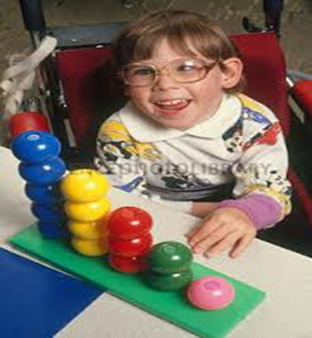
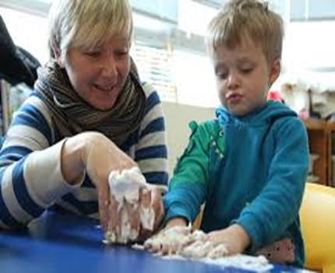
Games and activities that children find enjoyable

Slide 11
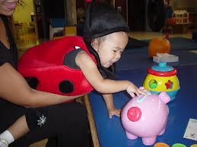
Everyday situations can be used as learning opportunities
Encourage children to actively explore and observe the world around them.
Encourage them to touch and handle objects.
Notes:
Children with perceptual reasoning issues may also have trouble in social situations because they do not pick up on subtle facial expressions and other nonverbal cues.[

Slide 12
Verbal comprehension and speech impairment
Difficulties in understanding spoken language/expressing language.
Dysfunction of auditory short-term memory and long-term memory.
Expressive and receptive language correlates with narrative (story retelling) ability and auditory memory.
Difficulties with following instructions and understanding concepts.
Difficulty expressing themselves e.g. naming objects, maintaining a conversation, making a choice or request and finding the words they need.
Notes:
Special education teachers and Speech and Language Therapists.

Slide 13
Communication impairment: This complex function is essential to school and social inclusion
Production of speech, language and gesture for communication is often affected by C.P.
Communication difficulties can be multifactorial, arising from motor, intellectual and / or sensory impairments.
Use of augmentative and alternative communication (AAC) systems, such as symbol charts or speech synthesizers.
Some children may be slow to respond - so allow adequate time for responses.
Encourage and accept every attempt made by the child to communicate whether by speaking, looking or gesturing.

Slide 14
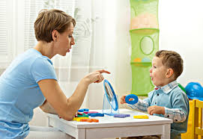
Children with motor impairments often have dysarthria, which affects the tone, strength and coordination of the muscles used for speech.
Resulting speech difficulties can range from mild, with slightly slurred articulation and breathy voice, to profound, with an inability to produce any recognizable words.
Recommendation guidelines include parent-infant transaction programs.

Slide 15
Difficulty to explore environment
Weakness, muscle spasticity and deficient balance make it difficult for children with CP to participate in outdoors games and activities with their peers.
Lack of motivation and confidence, negative experiences, poor support from family diminish the child’s opportunities to explore environment and confine it in a restricted circle of routine activities within a well-known and never changing world.

Slide 16
Barriers to physical activity participation
Usual barriers are practical limitations, time constraints and priorities, lack of accessible and inclusive opportunities.

Slide 17
Facilitators to physical activity participation
Planning programs of appropriate and inclusive opportunities to be active, make physical activity look fun, enroll parents. Both parent and child commitment to a physical activity.
Parents enable and support performance of meaningful activities and enable, change and use the environment either by choosing the right type of activities for facilitating social contacts, either by avoiding dangers or negative attitudes of other people.
Family-to-family support may enhance physical activity participation.

Slide 18
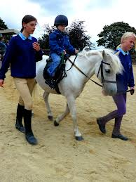
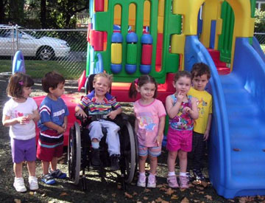
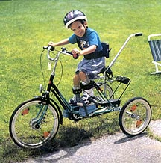
Frustration must be avoided by starting with activities that are manageable and rewarding.

Slide 19
Diminished self-esteem
Children with C.P. experience reduced quality of life and self-concept compared with typically developing peers.
They may differ from their classmates with respect to social status, number of reciprocated friendships, sociability/leadership, social isolation behavior, verbal and physical victimization.
There is a hypothesis that children with cerebral palsy begin to regard themselves as different as early as four years of age.
However, these self-views and their potentially negative effects on self-esteem do not appear to crystallize until the children are in the primary school.

Slide 20
Additional difficulties…
Slowness of thought and reaction
Attention deficit disorder
Obsessive Compulsive Disorder
Oppositional Defiance Disorder
Autism

Slide 21
“Opportunity window”
Formation of a huge number of synapses during the first year of life and the pre-school period enhances memory and learning, as well as behavior modification and social adaptation. Early intervention takes advantage of this “opportunity window”.
The early childhood field should therefore combine cognitive-linguistic enrichment with greater attention to preventing, reducing, or mitigating the consequences of significant adversity on the developing brain, in order to offer a better future to children with CP.
Parent empowerment and enrollment is the key to successful intervention.

Slide 22
Parent enrollment
Understanding the experiences of parents with their child's intervention might help meet the needs of parents and, subsequently get them engaged in their child's intervention.
As parents' early beliefs regarding their child's intervention have consequences for treatment participation, it is important to understand these parental perspectives.

Slide 23
Evidence for the effectiveness of Early Intervention (1)
Spittle et al., (2015), with a meta-analysis of 25 studies (3,615 children) on early intervention results in infants born prematurely, concluded that the long-term benefits of relevant programs remain unclear and controversial.
Recently, Hadders-Algra et al. (2017) also reviewed the literature on the outcomes of intervention in infants with CP. They found a positive correlation between the intensity and extent of the interventions involving the child and his / her family and the final results, but considered that the literature was limited and heterogeneous and a systematic inquiry into the relationship between early intervention and outcome had to be done.

Slide 24
Evidence for the effectiveness of E.I. (2)
.
According to Gannotti (2017), the intensity of physiotherapy programs (increased frequency and duration of sessions) in infancy, utilizes intense neuroplasticity and can improve lasting improvement.
New technology, social support for the family, adaptations of the natural environment enhance participation and stability in high intensity programs.

Slide 25
Evidence for the effectiveness of E.I. (3)
In order to evaluate the Early Intervention results, well-designed surveys involving a large number of infants and toddlers are required. The correlation of the effects of rehabilitation with reconstructive plasticity imaging (MRI, fMRI, dTI) can provide evidence for the effectiveness of interventions.

Slide 26
Evidence of effectiveness of early intervention (2)
The neuroimaging brain study in infants and toddlers is not yet affordable and feasible on a large scale, but expanding its use will shed light on the mechanisms of reorganization of the young brain and will allow for more focused planning and assessment of early intervention methods.
Neuroimaging allows for better investigation of the etiology and pathogenesis of brain damage in CP and helps to monitor the changes brought about by reconstructive plasticity and therapeutic intervention.

Slide 27
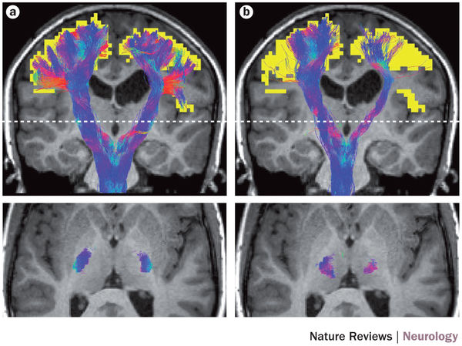
dTI (diffusion tensor imaging)

Slide 28
Transition and inclusion to kindergarten
Family, therapists and staff cooperate in planning a smooth transition, through sharing information and arranging visits before the child starts.
Inclusion in all the daily activities of the early childhood setting (free play, group times, routines and alternation of activities), to promote development of social competence and self esteem.
At a later stage, Individualized Education Program.

Slide 29
Transition and inclusion to kindergarten

Slide 30
Kindergarten: good practices
Change the equipment and plan how materials will be presented, so that the child with cerebral palsy can participate as much as possible in all areas of play and activities.
However, use the same equipment for all children where possible – global design.

Slide 31
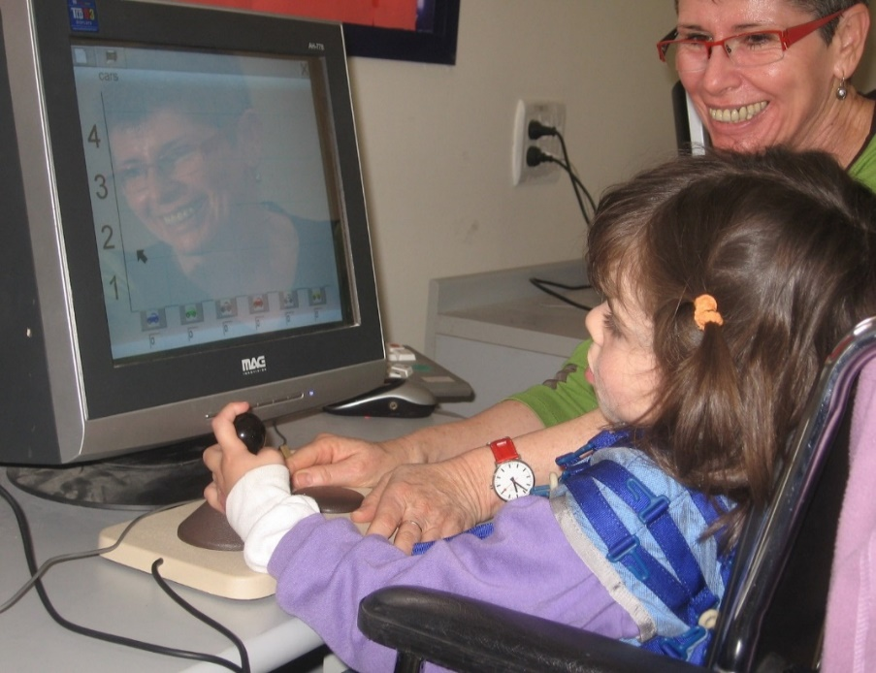
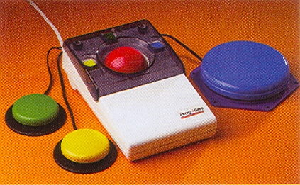
Early familiarization with new technology
Notes:
Full participation of children with motor and speech impairments in academic activities using these technologies requires another adult in class and adequate strategies to manage the extra time the child with disabilities may require to complete the activities.

Slide 32
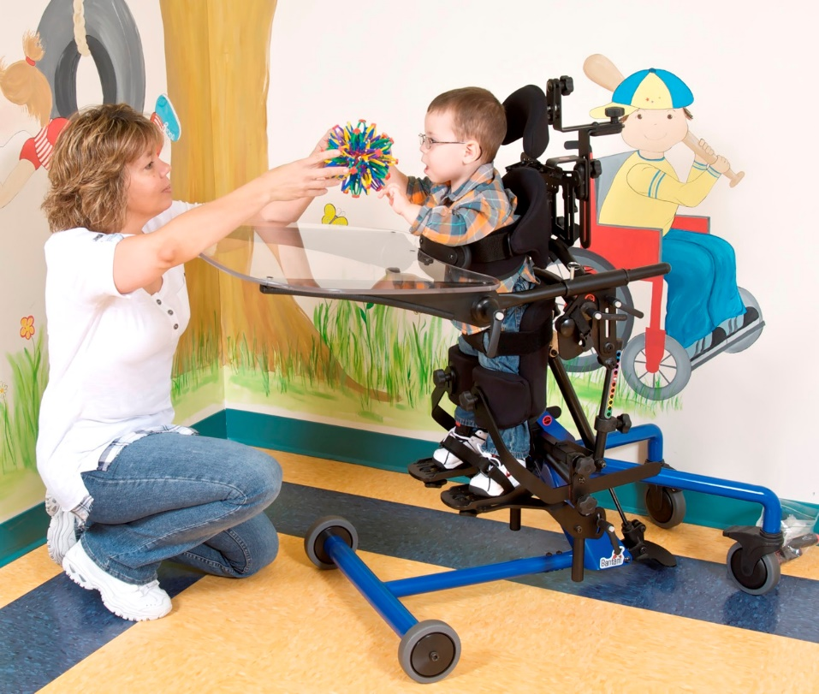
Ensure the child is positioned well with good posture and balance.
Some children may need more supportive seating on the floor or a chair. For some children, the use of a standing frame may enable them to participate more independently

Slide 33
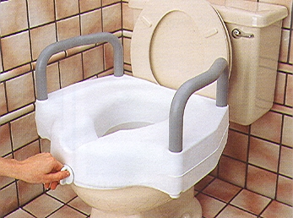
Mealtimes - Toileting

Slide 34
“One school for all” - Inclusion or Integration?
“If real integration is the aim, then the challenge becomes accepting more diversity. Diversity in learning abilities should be regarded as something positive and valuable, rather than something to eliminate.
Looking at integration in this light will mean challenges for educational research as well, since it will become more important to examine integration processes than to theorizing about inclusion.”
Emanuelsson, 1997

Slide 35
“Protecting brains, not simply stimulating minds”
“Curricular enhancements in early childhood education that are guided by the science of learning must be augmented by protective interventions informed by the biology of adversity. The same neuroplasticity that leaves emotional regulation, behavioral adaptation, and executive functioning skills vulnerable to early disruption, also enables their successful development through focused interventions during sensitive periods in their maturation.”
Shonkoff , 2011.

Slide 36
“Protecting brains, not simply stimulating minds”
Guided by the appealing theory of change and adaptation of the immature brain due to neuroplasticity, researchers, professionals and policy-makers must work together to design, implement and evaluate innovative strategies to produce substantially greater impacts.

Slide 37
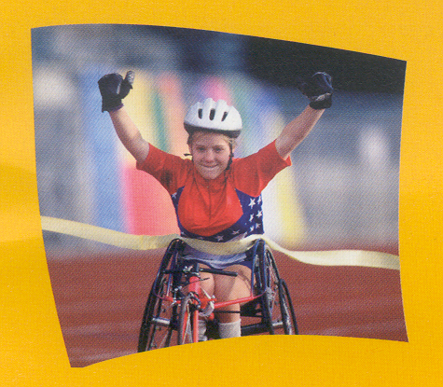
Thank you!

