Slide 1
Education and Inclusion Programs for Cerebral Palsy in Greece
Dr. Ioulia Nisiotou
Special Education Department
University of Thessaly, Volos, Greece
email: nisiotou@uth.gr

Slide 2
EΛΕΠΑΠ- ELEPAP
ELEPAP operates six fully equipped Centers in Greece:
Athens, Thessaloniki, Volos, Ioannina, Chania and Agrinio

Slide 3
ELEPAP-Rehabilitation for The Disabled- more than 80 years of history
ELEPAP supports the development of children with physical disabilities and developmental difficulties and provides support to their families.
ELEPAP offers a series of integrated intervention programs for infants, pre-school and school- age children.
Furthermore, ELEPAP cooperates with the Public Special School operating in its facilities.

Slide 4
ELEPAP therapeutic interventions
Programs of holistic approach, depending on the developmental needs and abilities of each child.
Personal, team, and inter-disciplinary scientific programs.
At regular inter-disciplinary scientific consultations, each child’s progress is monitored, new targets are set and personal programs are created.
The aim of all programs and interventions at ELEPAP is the reinforcement of motor, sensory, verbal, cognitive, social, emotional and intellectual development.

Slide 5
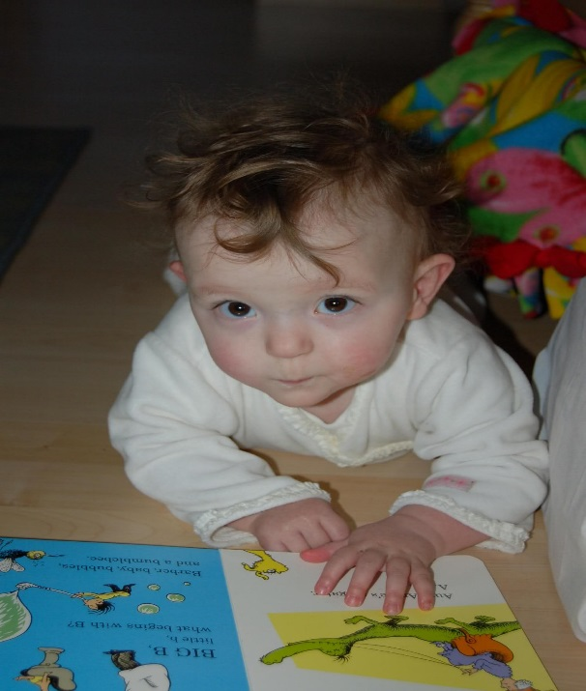
Infant Intervention program
This is an individual treatment program, addressed to infants up to 18 months and their families, according to the needs of each child.

Slide 6
Early Intervention
Holistic Educational Approach
• Customized Teaching
• Learning through experience
• Group collaborating Teaching
• Multisensory Approach
• Interdisciplinary Teaching

Slide 7
Gait and motion analysis center

Slide 8
Since 1972

Slide 10
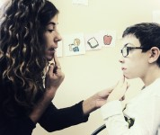
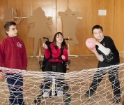
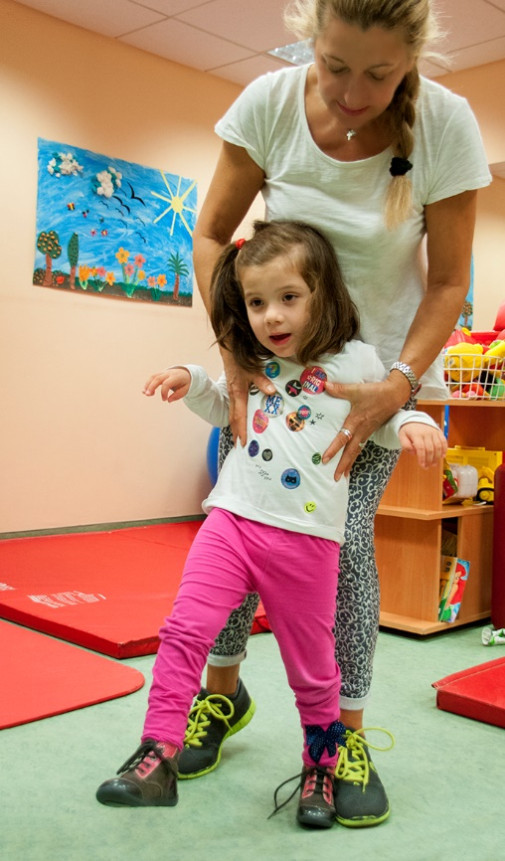
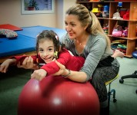
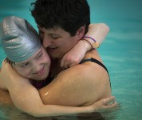
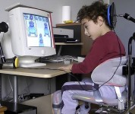
45 years of activity and research

Slide 11
Public Special Education schools in Greece
School year 2015-2016
All education levels
415 students with mobility disorders
1416 students with multiple disabilities
Preschool education
36 students with mobility disorders
142 students with multiple disabilities

Slide 12
Public Special Education schools in Greece
Primary schools
156 st. mobility disorder
660 st. multiple disabilities
High school
48 st. mobility disorder
69 st. multiple disabilities
Lyceum
24 st. mobility disorder
44 st. multiple disabilities

Slide 13
Better first in the village than second in Rome?
Mainstream Schools
Special Education Schools
Inclusion classes
Parallel support
Collaborative practices between teachers

Slide 14
Special Education Teacher:
Individualization of teaching strategies
Practices for differentiation of the curriculum
Knowledge about specific difficulties and handicaps
Skills for assessing individual needs and abilities
Practices for behavior analysis

Slide 15
Collaborative teaching
Supportive- parallel teaching
Complementary- alternative teaching
Group teaching
Supportive educational activities

Slide 16
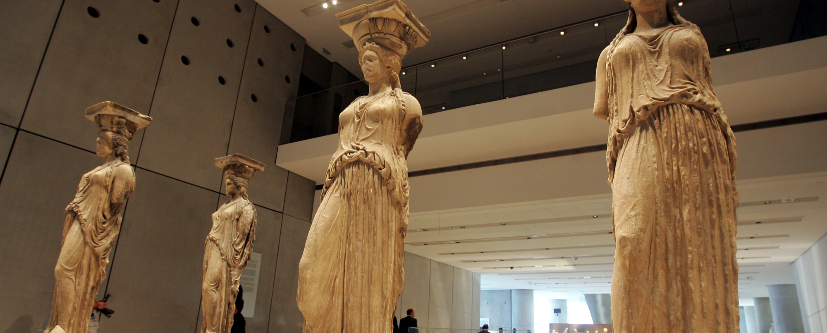
Differentiated activities and programs : art and science museums, archeological sites, excursions of ecologic interest
Pedagogical and instructive purpose and planning
Opportunities for extra knowledges and experiences
Inclusion and interaction with other students or adults

Slide 17
Differentiated activities and programs : museums, archeological sites, excursions of ecologic interest (2)
Some students find it difficult to take initiatives and to find their place in the group, so planning activities should help the student to mobilize, actively participate and communicate with his classmates in a more relaxed environment than that of the class.

Slide 18
Differentiated activities (3)
Quality of programs for teaching arts, archeology, science, environment, but also modifications in order to maintain the interest of adolescents .....

Slide 19
Accessibility center "PROSVASI" ("ACCESS") at the University of Thessaly
Facilitates the physical, academic and social access of students with disabilities
Offers information and support to students with disabilities in order to enhance their access and inclusion at the University
Informs and helps the faculty and administrative staff regarding differentiating and inclusive practices for students with disabilities.

Slide 20
“A school should not be a preparation for life. A school should be life.” E. Hubbard

Slide 21
https://youtu.be/ZrthwpJZZe8?t=47

